Slide 1
Yotto.in
By Local Businesses, For Local People
HYPERLOCAL AGGREGATION ECOSYSTEM
empowering MSMEs & Unorganized Sector Businesses
including
Grocery Stores, Restaurants, Pharmacies & more
(and their Supply Chains and Customers)
Our ERP Product: DigitalBricks.co | Our Company: www.YottoLabs.com

Slide 2
Summary: Empowering MSMEs to Disrupt Retail Aggregation
Post-COVID-19, Contact-less Home Delivery will continue to explode.
Today, Super-Aggregators & a few players / de facto proxies control most of the GMV.
In Food Delivery, Aggregators & Aggregator-installed, often Predatory Dark / Central Kitchens are price-driving & killing Traditional Local Restaurants.
Legacy Restaurants & traditional local retail businesses are facing an existential threat from this monopolistic phenomenon, which will ultimately hurt customers badly, and also eliminate vast #s of local jobs & small businesses, the local economic | social-cultural fabric & tax-base, hurting worst the working poor, those most vulnerable, and local govts.
Most Local Restaurants, Grocery, Liquor, Pharma, etc. shops today seek a savior, an alternative Onlining & Delivery Platform, -- unaffordable for small businesses.
Enter ... The Solution -- Yotto.in – an Alternative Aggregator, which prioritizes empowering the current local businesses – enabling their smooth onlining to a powerful, proven Software-&-App-&-Delivery Ecosystem, monetizing a Novel Distribution Channel, protecting millions of local jobs & families – all while creating great value for all stakeholders.
Need ~ 28 Cr - Yr 1 …
Creating Value ~ 3600 Cr by Yr 4
Growing 5k+ New Entrepreneurs 30k+ Jobs
Interested yet? … Read on, and then contact us to engage / join hands!

Slide 3
Table of Contents
START
Problem Statement
App Ecosystem
Contactless Ordering
Choice of Hardware
Working of Ecosystem
Scaling with Partners
Faster On-boarding
Who pays whom
Economy of Partners
EV / More Ecosystem Power
Blockchain & Crypto Power
Partner On-boarding
TAM/SAM/SOM
Yotto vs. Zomato/Swiggy
Projections | Burn Rate
END
Mandate-holder | Contact
People
SWOT Analysis
Software Costing

Slide 4
Yotto.in
Delivered.
From & By Your Trusted Local Shops!
Powered by

Slide 5
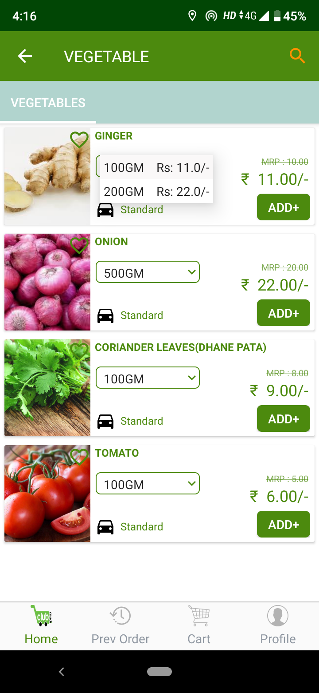
It’s 8 AM in the Morning! No onions for the Sambar!
Mrs. Iyengar opens the ‘Yotto.in’ App on her phone, goes to ‘Grocery Stores’, and then selects ‘Shivam Supermarket’, just 300 meters from her home!
She selects ‘Onions’ in the App, and then, bingo, she remembers many more items to order. She places her orders, and reviews her order cart - it is Rs. 567! So no delivery charges!
She gets busy making Chapati and Rice for lunch. In 20 minutes, Karthik from Shivam arrives with her ordered items. Karthik gets good tips every time from Mrs. Iyengar and hence she always gets the fastest service!

Slide 6
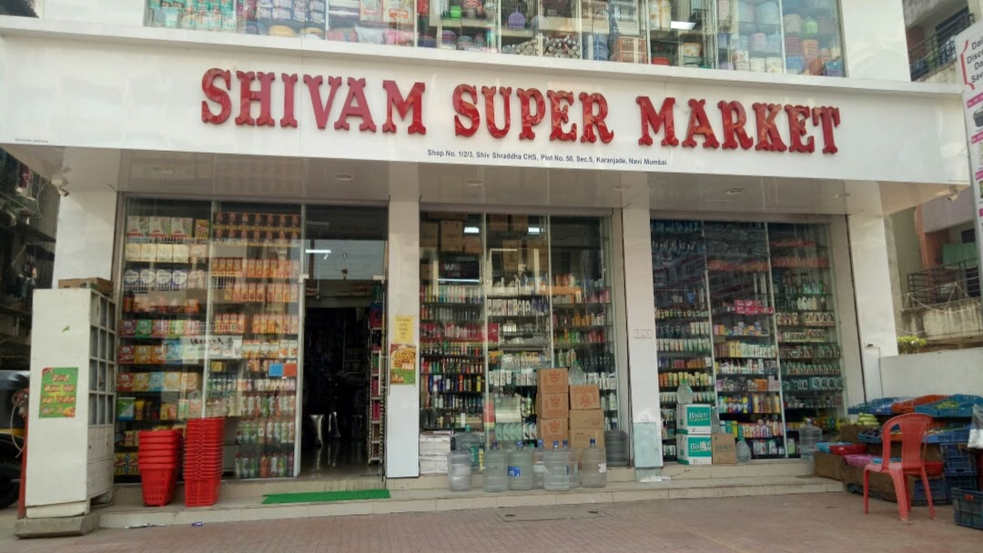
8.01 AM: The RetailPro App at Shivam Store starts ringing!
Mr. Shetty, 65 years old, just opened his store at 7.30 am.
His phone rings!
Yes, a new order has come in. 11 items,
Rs. 567!
It’s going to be good day today!
Mr. Shetty prints the bill from his phone with 1 click and hands over to Karthik to complete the delivery.
Karthik looks at the bill and sees “Mrs. Iyengar”. Karthik is happy to make this delivery. Not just tips, but even a few sweets are common at her place!

Slide 7
Behind the Scenes - How it Works
Yotto.in @Cloud
Retail Store
Delivery Person
Retail Store
Retail Store
Place Order
Order Onion + 10 items
Thanks. OTP.
Print Bill &/ Or Order Ticket
Handover to Store
Delivery Boy
Prepare delivery package
Start
Delivery
Handover to consumer
Collected
Payment
Payment
Hand over payment
Shivam Store
@CV Raman Nagar
Karthik
@Shivam Store
Mrs. Iyengar
YottoLabs

Slide 8
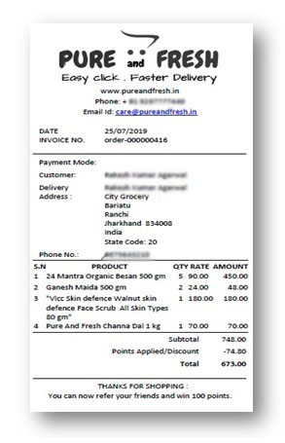
Yes, It’s Contactless Ordering for the Post-Pandemic World
Order
New Order
SMS OTP
Accept Order
Print Bill With QR Code
Order Ready
Pick up please
Customer comes to counter
Customer
Yottolabs Server
Collect Payment if CoD
Businesses
Customer @ Counter
Customer gives OTP
Order Completed
Enter OTP
Client Branded Ordering App
Yotto Server @ Cloud
Yotto PoS
Client Branded Ordering App

Slide 9
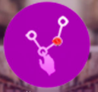
Ecosystem includes (but is not limited to) many Apps, Portals …
For the Consumers to order from home or in-premise or on table
Our full function PoS Application for Large SKU Grocery & Fashion Retailer
Consumer App/Portal
POS Pro
Retail Pro
Our full function PoS Application for F&B and Low SKU businesses
Online or in-premise Ordering
Omni Channel Ordering & Billing
Omni Channel Ordering & Billing
For Delivery Person to pick up order and complete delivery including Map help
For Order Fulfilment Staffs in Kitchen, Factories, Order Fulfilment Centres
InSite App/Portal
Runner App
SORT
For Backend staff to do core Inventory & other business functions.
Delivery App
Smart Order Handling
Core Inventory Management
RRM
InSite Manager App
FOSCC
For Saloon, Diagnostic for Managing Appointments etc
Do basic Approvals for Discount /Bill Edit/PO/Transfers etc. Rest of the functions are from Portal
For Agents in Call Centres at Multi-outlet businesses where call centre is used for tele-ordering
Telephone Ordering
Resource Reservation Manager
Approvals & Supervision

Slide 10
Use Proven Crowd-Sourcing Model to Scale Deployment
Unlike Other / Legacy Aggregators, we propose to use Crowd-Source Partners, who are essentially small Entrepreneurs, who employ a Few Activation Engineers & a Few Delivery Persons in his/her area, catering to local businesses.
India is the Land of Micro-Entrepreneurs!

Slide 11
Explanation: Who / What is a ‘Partner’?
Tally is the most popular accounting software used by India's MSME sector, used by maybe about 70% of MSMEs.
One of the main ways in which Tally markets its ecosystem to MSME Clients is through a network of 'Tally Partners'. These are typically small businesses, often C.A. firms, who (serve MSME businesses with other services, but also) act as a channel to on-board said MSME firms on to the Tally Accounting software platform.
We also intend to use this network of (interested) 'Tally Partners' to market the Yotto.in platform to their suitable MSME clients. In effect, the 'Yotto Partners' will be Franchisees who will market the Yotto.in platform (which is already pre-configured to feed in to Tally Accounting) to their interested and suitable MSME 'Clients', and also provide from an array of other Yotto.in-adjacent services to said target Clients, e.g., Yotto Local Logistics / Delivery services, Accounting or Legal services, etc. All of this should earn these 'Yotto Partners' a substantial income that would keep them incentivized and motivated to partner with us on an ongoing basis to both market and operate the Yotto.in platform to an extensive cross-section of MSMEs.
Not being employees, but rather independent contractor Franchisees of Yotto.in, these 'Partners' will conduct their own (territory-specific) Yotto.in businesses with their own invested capital -- onboarding more and more Client MSMEs on to the Yotto.in ecosystem. And we will earn an ongoing Franchise income from their activities.
In addition to the Tally Partners, we also plan to reach out to the fast-growing segment of seekers of Franchise Business Opportunities in the market -- to sell them the Local Yotto Partner / Yotto.in Partner Franchise Business Opportunity.
Our team includes members ready and experienced in this area.
.

Slide 12
Working of The Ecosystem
Yottolabs
Retail Store
Retail Store
Retailers
I want to join Yotto.in
Please pay Activation Charge
Activation Team
Delivery Pool
Paid
Please Initiate Activation now
Yotto Partners
Do you need Delivery Service?
Yes
Pay Advance for Rs. D Delivery @d/Bill
Paid
Enable Delivery Service Also
Visit Retailers
1
Install Printer cum WiFi Access Point
2
Upload Catalog & Give Training
3
Install & Train Software
4
Optional - Activate Delivery Service
Activation Complete
Pay for Activation
Here is your payment

Slide 13
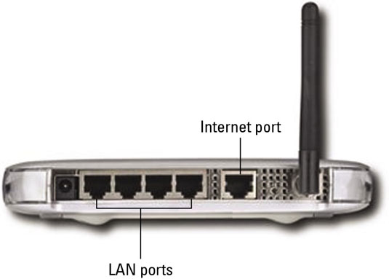
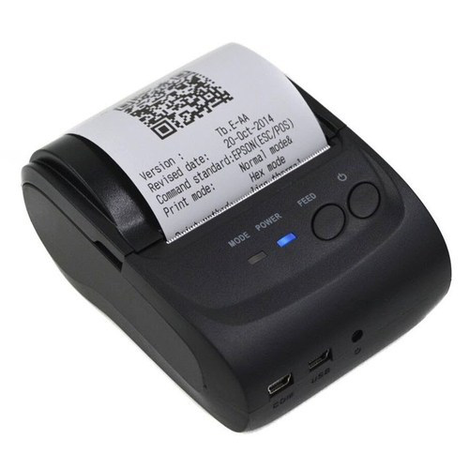
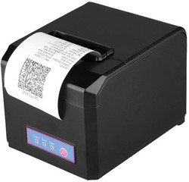
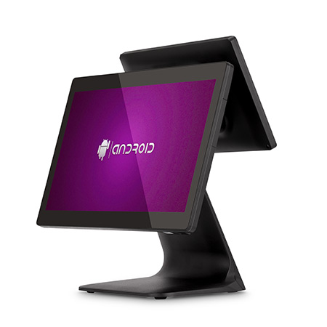
Diverse Choice of Hardware for Every Format
Tiny Shop
Small Shop
Big Shop
Slow Billing
High Speed Billing
Multi PoS
Wired Internet Connection
Wired Internet Connection
PoS
Software
LAN Cable
Pos Software
USB/LAN Cable
1
BlueTooth Printer + Personal Android Phone
1
LAN Printer + WiFi Access Point + Android Tablet
1
LAN Printers + WiFi Access Point + Android PoS
2
2
Thermal LAN Printer Connected to LAN Port of WiFi Access Point
2
Thermal LAN/USB Printer Connected POS Hardware
Phone Internet is used
3
Android Tablet is connected to Access Point over WiFi for Internet Access
3
Android PoS Hardware are connected to Access Point over WiFi for Internet Access

Slide 14
Pre-configured Master Data to Download & Upload
Master Product Catalog
Hindustan Unilever Limited
Master Product List - Excel
✓
Brands | Category | Product Name | SKU | MRP | Selling Price | Image
HUL | Oral Care | President 100 ml, | 123456 | 126.00 | 126.00 | image1
HUL | Oral Care | President 50 ml, | 123457 | 74.00 | 74.00 | image2
HUL | Oral Care | President Powder 100 gm | 123458 | 120.00 | 120.00 | image3
HUL | Skin Care | Lakme Body Lotion 1000ml | 234567 | 1176.00 | 1176.00 | image4
HUL | Skin Care | Lakme Body Lotion 750 ml | 234568 | 996.00 | 996.00 | image5
HUL | Skin Care | Lakme Body Lotion 500 ml | 234569 | 700.00 | 700.00 | image6
HUL | Skin Care | Lakme Body Lotion 100 ml | 234569 | 200.00 | 200.00 | image7
HUL | Detergent | Surf Excel From Loader 4 Kg | 125785 | 557.00 | 557.00 | image8
HUL | Detergent | Surf Excel From Loader 2 Kg | 125678 | 257.00 | 257.00 | image9
HUL | Detergent | Surf Excel From Loader 1 Kg | 125677 | 157.00 | 157.00 | image10
Brand 1 - HUL
✓
✓
Oral Care
Skin Care
✓
Detergents
HUL
Patanjali
Dubur
Soap
✓
✓
✓
Hair Care
Tea & Coffee
Colgate
ITC
Non Brand
Food Spreads
Cereal
✓
✓
Ice Cream
Others
Others
Others
1
Select the Brands that is being sold in the store
2
Select the Product Sold in the store
3
Download this Excel to add stock values and selling price

Slide 15
Who Pays Whom
Yottolabs
Retail Store
Retail Store
Yotto Partner
Retailers
$X
Pays One Time Enrollment Charges
Activation Team
Delivery Pool
$Y
Pays Activation Charges
Pays for Hardware
$Z/Delivery
Pays Advance towards Delivery Charges
$0.z /Bill +
Pays SaaS Charges
Pays for Activation X
Part of $Y
Pays for Activation Y
Pays for Delivery X
Part of $Z
Pays Delivery Y

Slide 16
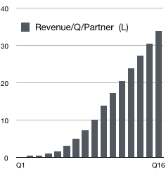
Making Each Partner An Economic Success
Yotto Partner
1
Few
Activation Team
10s
Delivery Pool
Invest 5L
3L / Month Assured Income 2nd year onward
INPUT
OUTPUT

Slide 17
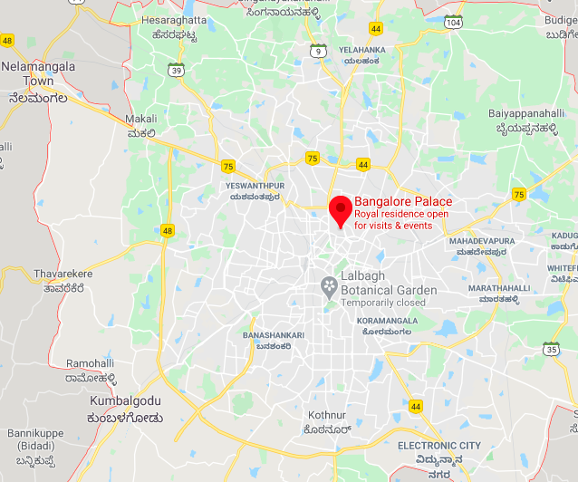
Novel On-boarding Scheme for ‘Partners’
Metros are divided into many Zones based on economic & population density as parameters. There will be 3 types of Zone:
Premium - Higher ATS (Avg Ticket Size)
High Density - More Orders
Normal
We plan to Auction these zones through bidding, in formal Events with food, fun and talks by local celebrities and our CEO.
Zones in Rural & Urban areas will be accordingly priced to make sure RoI of 10 to 15% is assured in 3 to 4 years.
Events will have tickets to cover the cost
P
HD

Slide 18
Will Offer Blockchain as Transactional Security
For Inventory Transactions, we will offer Blockchain Protection to every PO, Requisition, Transfer, Audit Process …
Client’s Vendors
Client’s HQ
Client’s Store
Client’s Outlet
PO Send to Vendors
PO Issued
Submit to Blockchain
Supply
For large distributed organisation, Blockchain brings huge cost saving by making human mediated audit redundant particularly for “Auto-Replenishment” process!
Allows easier inclusion of 3rd party Vendors/suppliers with better transaction Security and Automatic Inventory Transfers of Raw materials to vendors or receiving of delivery from vendors.
Makes Job-Works scalable to enable even individuals working from home
Stock Received
Submit to Blockchain
Transfer to outlet
Received
Submit to Blockchain

Slide 19
Crypto-Currency Ready
All payments to and from Partners and Clients can be made through Crypto or ‘Fiat’ currency bringing fund mobility & value increase (due to anticipated increase in value of crypto, unlike fiat currency, which normally depreciates).
Partners
Hyperlocal
Clients
Consumers
Pay in Crypto
Buy in INR or Crypto
Pay loyalty Points in Crypto
Pay Enrolment Fees in Crypto
Pay Cashback in Crypto
Pay Delivery Fees in Crypto
Pay to Partners in Crypto
Along with Blockchain, Crypto makes our end-to-end system complete auto-reconciliation for every transaction, making our system highly scalable for the size of hyperlocal aggregation in a country like India where there are millions of businesses catering to a billion+ population, needing millions of delivery persons and thousands of Partners.

Slide 20
Yotto Certification - More Revenue to Partners
Individuals and communities are looking for help in buying quality products conforming to their personal and family health requirement as well as their religious beliefs. For example Halal and Kosher are 2 such well known certification given to products. There is no such certification that is given to a Shop selling such products today.
HALAL
KOSHER
VEGAN
DIABETIC
JAIN
Enable Inventory Functionality of our product
Enable Compulsory Stock Adjustment on every Bill
Agree to Quarterly Inspection by Yotto Partners
Yotto Partners Use our Inspection App 'Pedlar'
New Colour Certificate Issued for current quarter
Payment for certification Collected
Quarterly Inspection starts. Backend Audit is done.
Consumer Feedback is Enabled

Slide 21
More Rev+Profit: EVs+Super-Batteries+Solar Charging Infra
‘Partners' must be incentivized to make Yotto.in viable, scalable and profitable. So we must create multiple revenue sources & cost savings for Partners, which are complementary and important to the core Aggregation business.
OpEx Savings Using EV
Addl. Revenue Streams
20 Orders / Day
3 Kms / Order
Yotto Partner
1
Petrol EV
New Tech Super-Batteries
Rs. 2.00 / KM
Rs. 0.20 / KM
Few
Maintenance & Repairs
x 20 x 3 x 30 x 12 =
x 20 x 3 x 30 x 12 =
Activation Team
Renting to Consumer
43,200 / Year
4,320 / Year
10s
Renting to Business
For 20-Delivery / day
10-EV Ecosystem, Savings ~ 400,000 / Year
Delivery Pool
Solar Panels, Charging Stns …

Slide 22
B2C APP
B2B APP
B2C + B2B Aggregation - More Power To Ecosystem
A Chicken vendor on our platform sells both B2C & B2B, e.g. to restaurants & to individuals, both customers buying chicken from the same chicken vendor. It must be noted that B2B Price is typically not visible to B2C customers. To achieve that, our system will enable a B2B App from which B2B buyers can register, see bulk prices, order, pay or use COD.
B2C Buyer
Yotto.in @Cloud
Fresh 24/7
Little Food Restaurant
1 Kg Potato from Fresh 24/7
1 Kg Potato from Fresh 24/7
2 Plate Biriyani from Little Food
B2C Catalog
2 Plate Biriyani from Little Food
I AM A BUSINESS
YES
50 Kg Potato from Fresh 24/7
B2B Catalog
It must be noted that our Partners can also be members of our Platform to supply, for example, Environmentally Safe Packaging Materials, Solar Power accessories & Batteries, etc. to all other members.

Slide 23
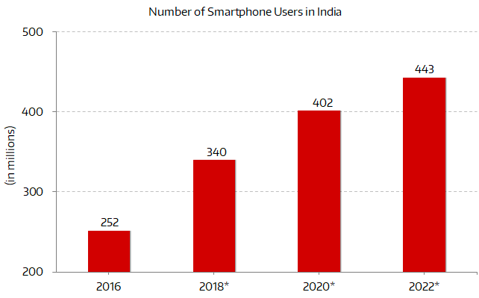
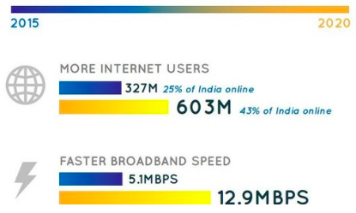
The Size of the Opportunity
Favourable Demography
Rapid Urbanisation
Nucleus Family
Younger Population
Change in Aspirations
Growth of Smart Phone Users
Growth of Internet Users
India
Low or Zero Training & Support Cost
Low Cost Hardware
Security > Windows
Mobility is Default
Touch is Default
Advantage Android
No Tech
Android
America

Slide 24
Yotto.in (‘HL’) vs. Other Aggregators (‘SZ’)
Zomato / Swiggy
Yotto.in (‘HL’)
Comments
Brand Hijacking
YES
NO
The game of the existing players is to become a Super-Brand subsuming the majority of the GMV through few of their own players
Customer Hijacking
NO
Marketplace runs on the principle that the Aggregators own the customers and do not share the customer contact with Businesses
YES
Uncontrolled Revenue Share
NO
For Legacy Aggregators, Business has no control or no say on Revenue share at all.
YES
The Game of Discounting
NO
The competition between Marketplaces to become top player forces them to run unhealthy price wars, which do not help Business
YES
Primary Stakeholders
BUSINESS
Yotto.in partners with Businesses and helps them to reach out to their own customers.
CONSUMER
Losing Loyal Customer to Competition
NEVER
We make sure Businesses own their own customers and not us.
ALWAYS
Customer Support By Business
ALWAYS
All customer support is handled by the Business. Only App failure related problem is handled by us.
NEVER
Listing inequality
NEVER
We never have listing premium. All listings are strictly by location with respect to customer.
ALWAYS
Rating Terrorism
Yotto.in has no incentive to manipulate rating. We will show each Business’s Google Rating as ranking.
ALWAYS
NEVER
Additional Cost for Digital Marketing
NEVER
We would NOT fool our Businesses with need for Digital Marketing. In HyperLocal.in, people will search for Business names.
ALWAYS
Private App/Portal
ALWAYS
Our offering comes with Private Portal, as well Private App, for each Brand -- as an optional feature at a small cost..
NEVER
Growing Brand of Business
ALWAYS
Our business model is to grow the brand of each Business every way and everyday! We act primarily as just the technology partner.
NEVER

Slide 25
Growth Projection of Ecosystem - Revenue

Slide 26
Growth Projection - Acquisitions (top) & Revenue (Rs. L) (bottom)
 | Year 1 |  |  |  | Year 2 |  |  |  | Year 3 |  |  |  | Year 4
 | Q1 | Q2 | Q3 | Q4 | Q1 | Q2 | Q3 | Q4 | Q1 | Q2 | Q3 | Q4 | Q1 | Q2 | Q3 | Q4
Acquired Partner Count | 18 | 18 | 60 | 108 | 234 | 306 | 378 | 450 | 486 | 486 | 486 | 486 | 486 | 486 | 486 | 486
Cumulative Partner Counts | 18 | 36 | 96 | 204 | 438 | 744 | 1122 | 1572 | 2058 | 2544 | 3030 | 3516 | 4002 | 4488 | 4974 | 5460
Acquired Customer Count | 0 | 54 | 108 | 576 | 1836 | 5256 | 11160 | 20196 | 33012 | 49392 | 61056 | 72720 | 84384 | 96048 | 107712 | 119376
Cumulative Customer Count | 0 | 54 | 162 | 738 | 2574 | 7830 | 18990 | 39186 | 72198 | 121590 | 182646 | 255366 | 339750 | 435798 | 543510 | 662886
Revenue & Revenue Split (Rs. L) | Year 1 |  |  |  | Year 2 |  |  |  | Year 3 |  |  |  | Year 4
 | Q1 | Q2 | Q3 | Q4 | Q1 | Q2 | Q3 | Q4 | Q1 | Q2 | Q3 | Q4 | Q1 | Q2 | Q3 | Q4
Total Revenue to Partners | 0 | 9 | 24 | 113 | 392 | 1192 | 2868 | 5883 | 10734 | 17923 | 26595 | 36867 | 48740 | 62214 | 77290 | 93966
Total Revenue to Company | 0 | 3 | 7 | 34 | 120 | 372 | 901 | 1867 | 3334 | 5460 | 7873 | 10692 | 13916 | 17545 | 21580 | 26020
Partner:Company | NA | 3 | 4 | 3 | 3 | 3 | 3 | 3 | 3 | 3 | 3 | 3 | 4 | 4 | 4 | 4

Slide 27
Revenue Streams (Rs. L) | Split | Year 1 |  |  |  | Year 2 |  |  |  | Year 3 |  |  |  | Year 4
 |  | Q1 | Q2 | Q3 | Q4 | Q1 | Q2 | Q3 | Q4 | Q1 | Q2 | Q3 | Q4 | Q1 | Q2 | Q3 | Q4
Partner’s Revenue from Client Enrolment (L) | 50% | 0 | 1 | 3 | 14 | 46 | 131 | 279 | 505 | 825 | 1235 | 1526 | 1818 | 2110 | 2401 | 2693 | 2984
Company’s Revenue from Client Enrolment (L) | 50% | 0 | 1 | 3 | 14 | 46 | 131 | 279 | 505 | 825 | 1235 | 1526 | 1818 | 2110 | 2401 | 2693 | 2984
Partner’s Revenue from Delivery(L) | 90% | 0 | 7 | 20 | 90 | 313 | 951 | 2307 | 4761 | 8772 | 14773 | 22191 | 31027 | 41280 | 52949 | 66036 | 80541
Company’s Revenue from Delivery (L) | 10% | 0 | 1 | 2 | 10 | 35 | 106 | 256 | 529 | 975 | 1641 | 2466 | 3447 | 4587 | 5883 | 7337 | 8949
Partner’s Revenue Hardware Sale(L) | 100% | 0 | 0 | 0 | 0 | 0 | 0 | 0 | 0 | 0 | 0 | 0 | 0 | 0 | 0 | 0 | 0
Company’s Revenue from Hardware Sale (L) | 0% | 0 | 0 | 0 | 0 | 0 | 0 | 0 | 0 | 0 | 0 | 0 | 0 | 0 | 0 | 0 | 0
Company’s Revenue from Usage Fees (L) | 50% | 0 | 1 | 2 | 8 | 29 | 88 | 214 | 441 | 812 | 1368 | 2055 | 2873 | 3822 | 4903 | 6114 | 7457
Partner’s Revenue from Sale of PoS (L) | 20% | 0 | 0 | 0 | 0 | 2 | 7 | 23 | 59 | 108 | 182 | 274 | 383 | 510 | 654 | 815 | 994
Company’s Revenue from Sale of PoS (L) | 80% | 0 | 0 | 0 | 1 | 6 | 28 | 91 | 235 | 433 | 730 | 1096 | 1532 | 2039 | 2615 | 3261 | 3977
Partner’s Revenue from Sale of Inventory (L) | 20% | 0 | 0 | 0 | 0 | 3 | 14 | 46 | 118 | 217 | 365 | 548 | 766 | 1019 | 1307 | 1631 | 1989
Company’s Revenue from Sale of Inventory (L) | 80% | 0 | 0 | 0 | 1 | 4 | 19 | 61 | 157 | 289 | 486 | 731 | 1021 | 1359 | 1743 | 2174 | 2652
Growth Projection - Revenue Streams

Slide 28
Burn Rate (Rs. Cr)
 | Year 1 |  |  |  | Year 2 |  |  |  | Year 3 |  |  |  | Year 4
Burn Rate / Qtr | Q1 | Q2 | Q3 | Q4 | Q1 | Q2 | Q3 | Q4 | Q1 | Q2 | Q3 | Q4 | Q1 | Q2 | Q3 | Q4
Marketing | 1.67 | 1.68 | 4.70 | 7.81 | 8.14 | 8.98 | 10.46 | 12.72 | 15.97 | 20.08 | 23.02 | 25.96 | 28.91 | 31.86 | 34.82 | 37.78
HR | 1.71 | 1.71 | 1.95 | 2.30 | 2.87 | 3.73 | 5.02 | 6.77 | 9.10 | 12.10 | 15.08 | 18.42 | 22.12 | 26.25 | 30.74 | 35.62
Software | 0.66 | 0.66 | 0.66 | 0.67 | 0.68 | 0.73 | 0.83 | 1.01 | 1.31 | 1.75 | 2.30 | 2.96 | 3.36 | 4.22 | 5.19 | 6.27
Revenue Loss | 0.00 | 0.09 | 0.24 | 1.12
Total Burn Rate (Rs. Cr) | 4.04 | 4.14 | 7.55 | 11.90 | 11.69 | 13.44 | 16.31 | 20.50 | 26.38 | 33.93 | 40.40 | 47.34 | 54.39 | 62.34 | 70.75 | 79.66

Slide 29
Rationale Behind Software Cost
Competition as Basis
Development Cost as Basis
Opportunity Cost for Client as Basis
1st there is no direct competition for our product (as of date).
The nearest are Shopify, LoveLocal and their lowest cost is ~30 $ per month/node!
None provide in-person help in installation which is mandatory for Retail at least for now
Degree of customization is difficult to estimate and hence cost is not known
This is certainly not correct model to arrive at the cost of A Software Product
It must be noted that this IP product created over years of hard work with substantial cash burn and loss of salary of the founding team!
Development cost of past years might not be same in today context
This is correct model.
Assume that the company start developing the software today,
how much Time &
Money would that need
In our experience this will need very experience team to create at least 2 to 3 years with at least 10 Engineers
Time = loss of business opportunity for client
Money = Risk without confirmed return
So our current price is very accurate!
Too expensive
Not a Correct Model
Correct Model

Slide 30
Software Run-Time Cost Breakup
$0.z /Bill
This is actual income of Yottolabs per order!
+
Payment G
Paid to Payment Gateway
+
Google Map
To be paid to Google
$0.z /Bill +
+
Push Alerts
To be paid to Google
+
SMS
To be paid to SMS Provider
+
Hosting
To be paid to Cloud Provider

Slide 31
SWOT Analysis
Strength
Weakness
Lowest Tech Cost
Novelty
<$0.05 / Order
Every new ideas comes with uncertainty
Internal
Fastest Penetration
Tech Heavy Team
Distributed Social Model with Micro-Entrepreneurs can scale up in India much faster than any Centralised Aggregators
Driven by Techies from Silicon valley and India
Size of Opportunity
Predatory Pricing
External
Total Available Market(TAM) is too big Ample room for Competition.
Competition may try to burn more money to continue subsidizepredatory pricing.
Market Readiness
Early Adopters
Our Competition has already spent huge sums of money forcing the market to adopt to the technology.
Conventional view is that Early Adopters have market advantage!
Opportunity
Threat

Slide 32
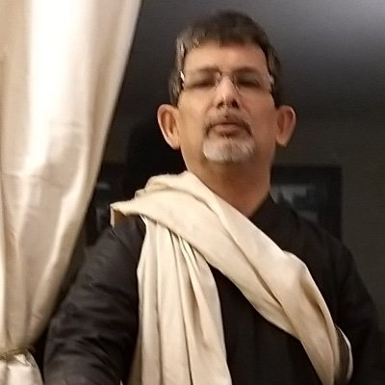
Leadership: CEO & Operations Team
Dr. Subir Saha, Ph.D. BITS, Pilani & NPL, New Delhi, Alumni, Tata Institute of Fundamental Research
Physicist, ex-(Motorola Labs, NSN, Hughes Software), with more than 30 Patents in Telecom, Data Security & Privacy, & Software. Hands-on experience of building Large-Scale Realtime Complex Server Applications with High-Availability, as Architect & Systems Engineer. Researcher in Retail with respect to Inventory & Supply Chain with key focus on Indian Wholesale Market. Designed every bit of the Yotto.in product ecosystem.
Business Scaling
Organisation Scaling
Server Scaling
CMO, Eman Kalyan Ghosh, B.Com, MBA
Dev Datta, COO, B.Tech, MBA
Director Engg, Debesh Mondal, B.Tech
Eman comes with solid background in scaling up businesses with Partnership & Franchisee across Metros and Rural Bengal through his past association with AIMCO.
He has 15 years of experience in Indian Commodity Exchange, National Spot Exchange, Aertherstone Capital (Geneva). He had also served the Calcutta Stock Exchange as Advisory Board Member.
His global reach with investors community is of serious help in seeking Yotto Partners.
Dev founded Orange Attire to build fashion retail distribution helping to connect the Retailers in Bengal.
His founded MSME PowerClub to help thousands of MSMEs in Bengal
He co-founded AIMCO (Key member of Indian Commodity Exchange) and had build a network of 500 HNI partners & 1000 Farmers in 1 year. Before this he had worked with Cognizant as Programmer Analyst for 3 years.
Grew with Yottolabs. Joined fresh from college and took part in product creation in every step as Junior Software Engineer to System Engineer to Director Engineering managing complete Development Team as well as the complete Onboarding Team. Debesh means “Problem Solved”.
Debesh’s appetite for learning key server technologies like Database Scaling & Server Load Balancing keeps Yottolabs’ Server Infrastructure state of the art, and yet lowest cost.

Slide 33
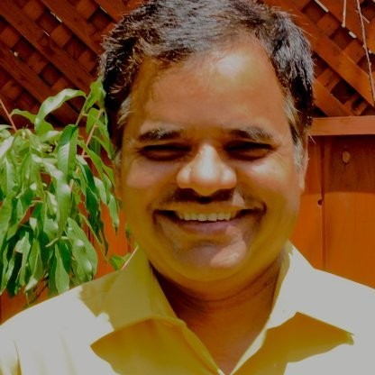
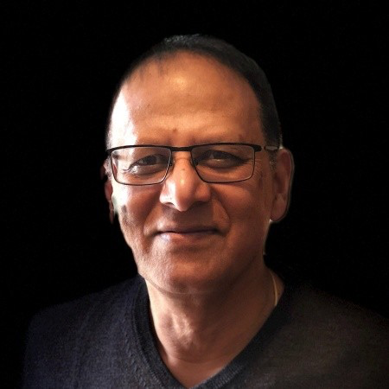
Other Core Thought-Leaders
“Gairik.com” Banerjee -- Ex-top Exec at Walmart Intl. USA, etc. (see CV). Intl. Co. Director, Restauranteur, Industrialist, Serial Entrepreneur by Calling, (Western World) Political-Economic Analyst by Practice, International Business Development functional specialist by Experience; and a Communicator / Story-teller / Narrative-Evangelist by Vocation. Global network including govt / diplomatic circles in many nations. Wants to take Yotto.in into various markets - N. America, Western & Eastern Europe, Russia, Latin America, AUS-NZ and MENA.
Advisor
Devendra Tripathi co-founded Yottolabs along with Dr. Saha. He is based out of California and has been Chairman of the Board of Yottolabs. He has been investing in Yottolabs since then. He has been a serial Entrepreneur and had a few successful exits. Devendra is a People Person and consensus-builder and value-creator in every occasion. He is ready to join Yottolabs America at any future opportune time for the North American market. Currently he is working as Associate Technical Director at Broadcom.
Investor
Alak Deb co-founded and worked together with Devendra in a few successful initiatives of their own.
Alak is based out of Silicon Valley, has had many successful exits and successful investments in many other startups as a Seed Investor.
Alak Eats Drinks & Sleeps Technology.
Alak is now working at A10 Networks and is ready to join Yottolabs America in the future.
Investor

Slide 34
Recognitions
Red Herring Top 100 Asia 2013
2011

Slide 35
Next Step | Contact
Potential Investors with easily and visibly evident means, readiness and interest, serious about investing in our project / company in the immediate or near future,
are invited to contact the below Mandate-holder
Gairik Banerjee +91 988 34 34 900
gb2345@gmail.com
Skype: gairikbanerjee

